Slide 1
Blindness Detection
CS 584 – Machine Learning
Girish Rajani-Bathija (A20503736)
Shriya Prasanna (A20521733)
Bhavesh Rajesh Talreja (A20516822)

Slide 2
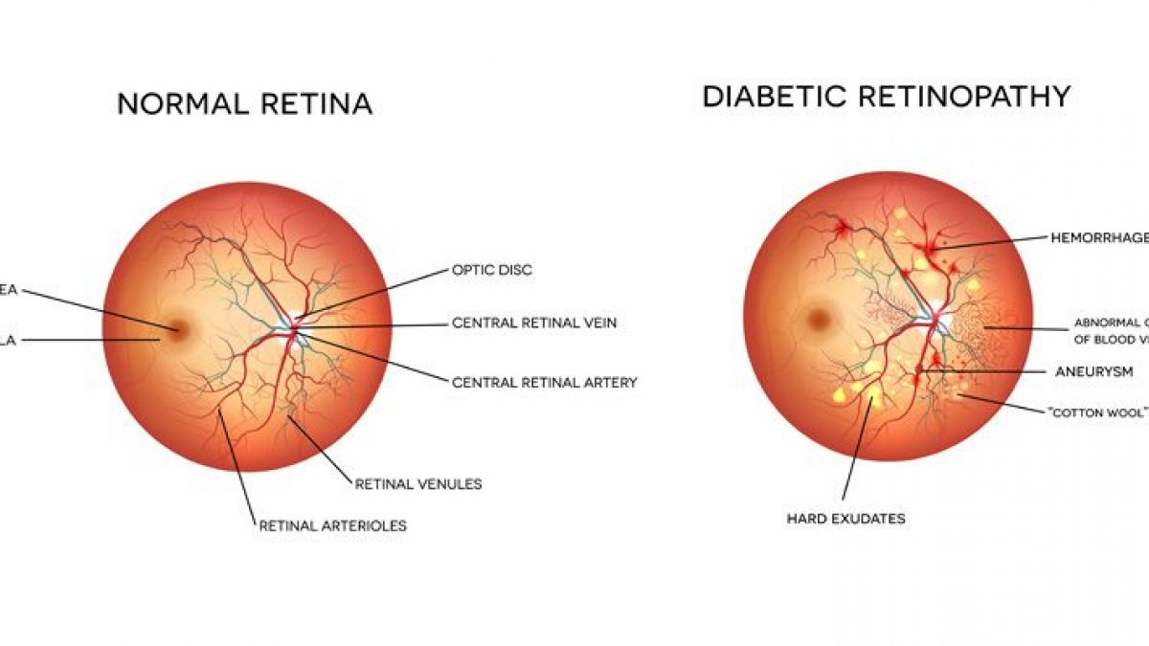
Problem Statement
Diabetic retinopathy is one of the most common causes of blindness in people who have diabetes
It is important to take a screening exam for early detection
Lack of infrastructure and skilled professionals in some rural areas
Very time-consuming and labor-intensive

Slide 3
Proposed Solution & Dataset
Implement various Deep Learning models to perform multi-class image classification.
Dataset: APTOS 2019 Blindness Detection dataset
Contains 3,662 training (later split into 2,462 training samples, and 1,200 validation samples) and 1,928 testing retina images. Each image is labelled as belonging to 1 of 5 classes:
Custom CNN Model
VGG-16
ResNet
InceptionV3
0 - No Diabetic Retinopathy
1 - Mild
2 - Moderate
3 - Severe
4 - Proliferative Diabetic Retinopathy

Slide 4
Workflow
Data Exploration
Data
Pre-processing
Data
Modelling
Evaluate Results
Label Test Data
Split images into training & validation
Resize Images
Image Augmentation
Custom CNN
VGG16
ResNet50
InceptionV3
On Val data
Hyperparameter tuning
Regularization techniques
Plotting loss and accuracy
Different dimensions
Unbalanced dataset
Predicting labels for test data using each model

Slide 5
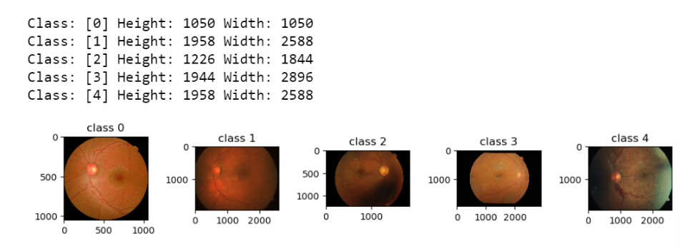
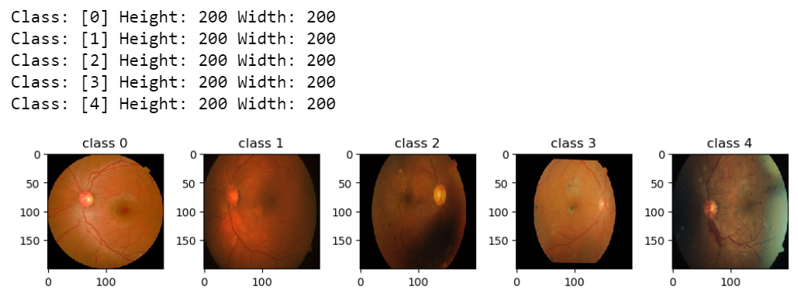
Data Exploration
Images within the dataset had different dimensions ranging from 474 x 358 pixels to 3388 x 2588 pixels. For uniformity, all images were resized to 200 x 200 pixels.

Slide 6
Dataset Class Imbalance
The distribution of samples among the five classes varies significantly
Perform image augmentation (rotation - 90°, 180°, 270°) on classes 1, 3, and 4 to create more samples and achieve a more balanced dataset

Slide 7
Dataset Class Imbalance Cont’d

Slide 8
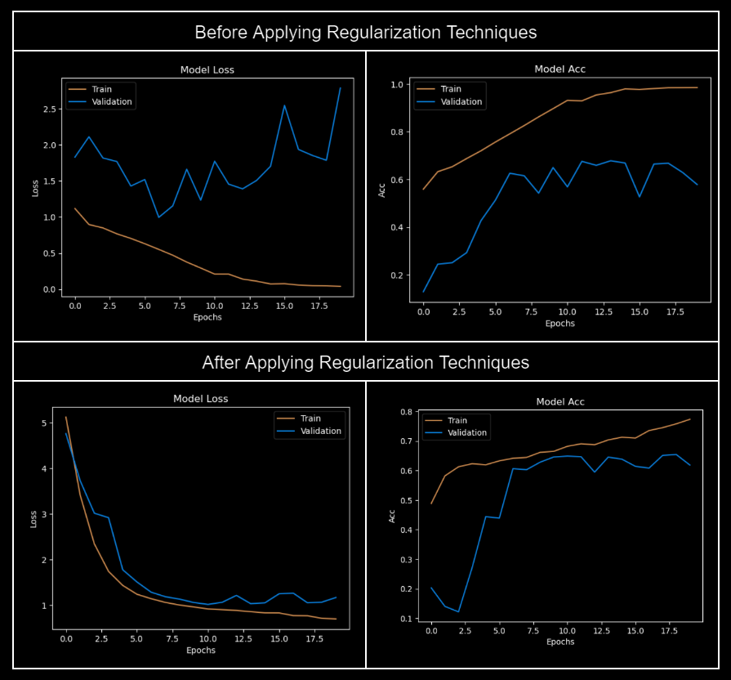
Custom CNN Model Results

Slide 9
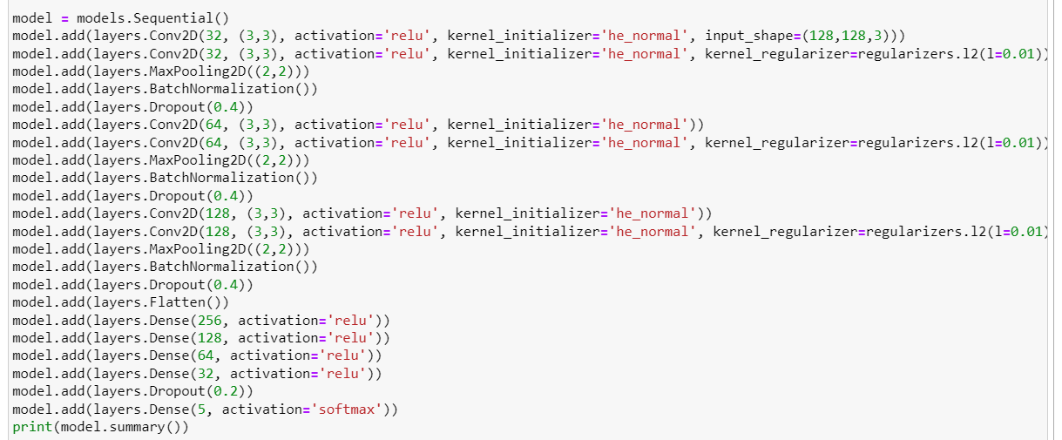
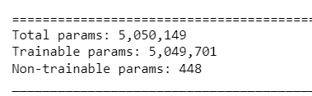
Custom CNN Architecture
Regularization Techniques:
L2 regularizer
weight he initialization
dropout layers

Slide 10
Results after Training
Training Parameters
Optimizer: Adam (lr – 0.001)
Loss: Categorical Cross-entropy
Epochs: 20
Model | Train Accuracy | Val Accuracy | Train Loss | Val Loss | Parameters
Custom CNN Model | 77% | 62% | 0.70 | 1.17 | 5,050,149
VGG16 | 81% | 66% | 0.50 | 0.91 | 14,789,205
ResNet50 | 70% | 66% | 0.86 | 0.97 | 25,826,693
InceptionV3 | 80% | 65% | 0.90 | 1.29 | 21,952,805

Slide 11
Results after Training Cont’d
Model | Train Precision | Val Precision | Train Recall | Val Recall | Train F1_Score | Val F1_Score | Train AUC | Val AUC | Parameters
Custom CNN Model | 0.83 | 0.69 | 0.70 | 0.54 | 0.76 | 0.60 | 0.96 | 0.88 | 5,050,149
VGG16 | 0.85 | 0.71 | 0.76 | 0.59 | 0.80 | 0.64 | 0.97 | 0.90 | 14,789,205
ResNet50 | 0.79 | 0.74 | 0.58 | 0.55 | 0.67 | 0.63 | 0.93 | 0.91 | 25,826,693
InceptionV3 | 0.84 | 0.70 | 0.74 | 0.60 | 0.79 | 0.65 | 0.96 | 0.90 | 21,952,805

Slide 12
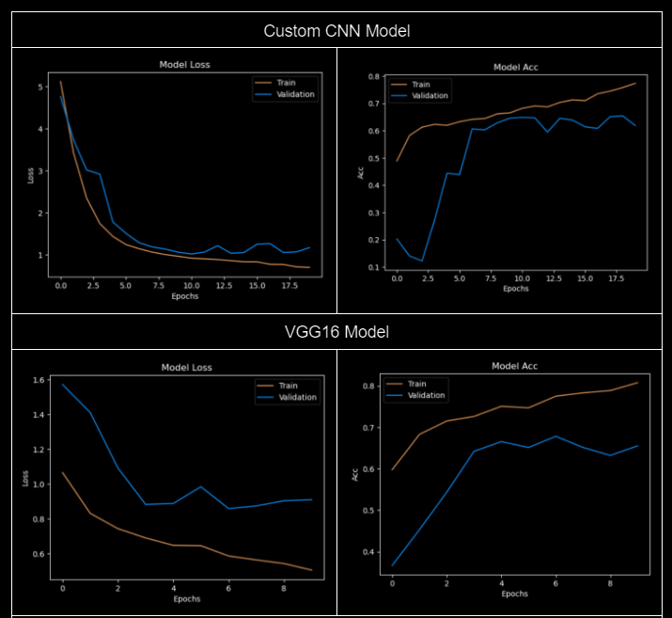
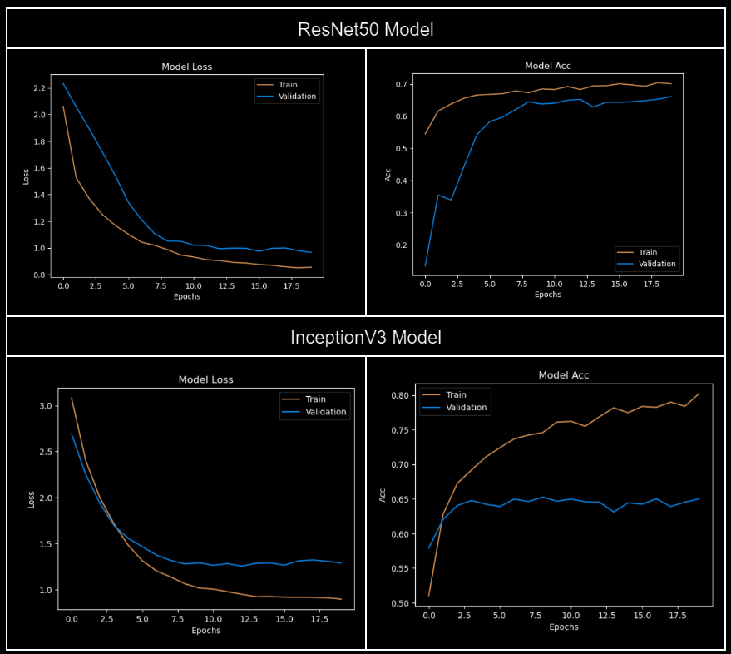
Results Visualization

Slide 13
Planned Future Work
Retrain the models with data augmentation and compare the results if data augmentation increases performance
Continue tuning hyperparameters to increase accuracy without overfitting
Classify/Predict labels for Test Data
If time permits, perform logistic regression and ET decision trees
In the future, our group plans to extend this project by developing a model that uses retinal fundus images to predict the age at which a patient on an unhealthy dietary plan is likely to suffer from blindness due to retinopathy. However, this is outside the scope of the current project.

Slide 14


